Slide 1
Sunshine State Young Readers Award
Mrs. O’Brien
2025-2026
4100
#2

Slide 2
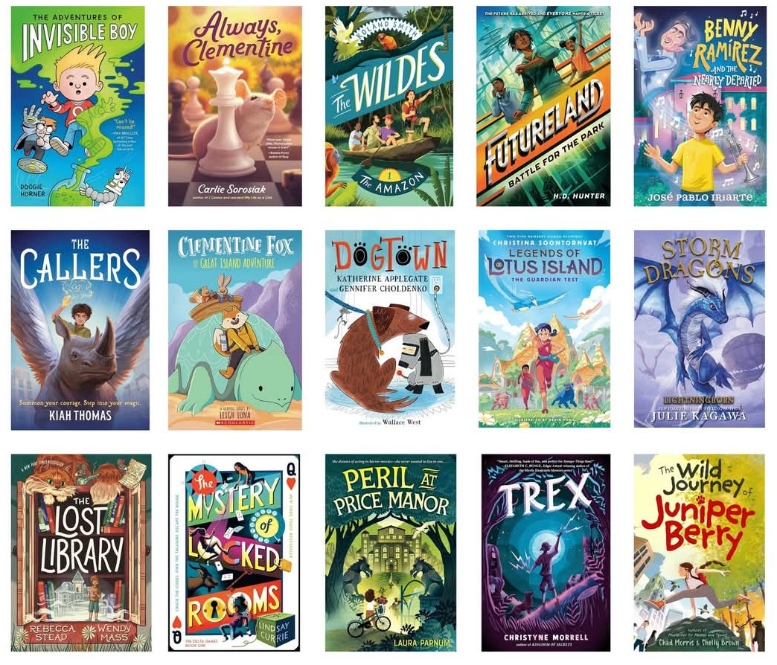
Read 3 or more of this year’s list and you are eligible to vote, earn rewards, and more…

Slide 3

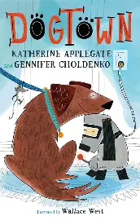



WHICH ONE WILL YOU READ FIRST?

Slide 4
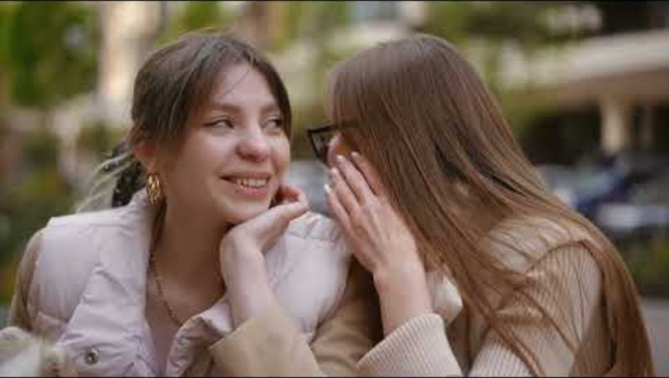

Slide 5


Slide 6


Slide 7


Slide 8
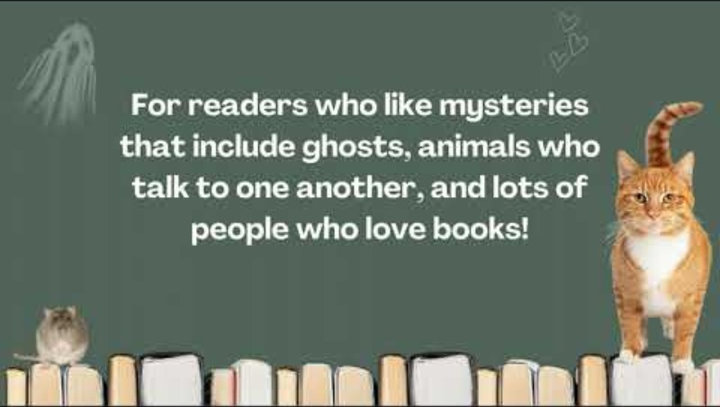

Slide 9

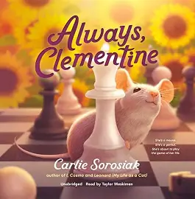



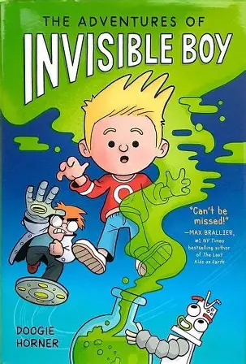
MEET THE AUTHOR & FIRST CHAPTER TEASERS…

Slide 10
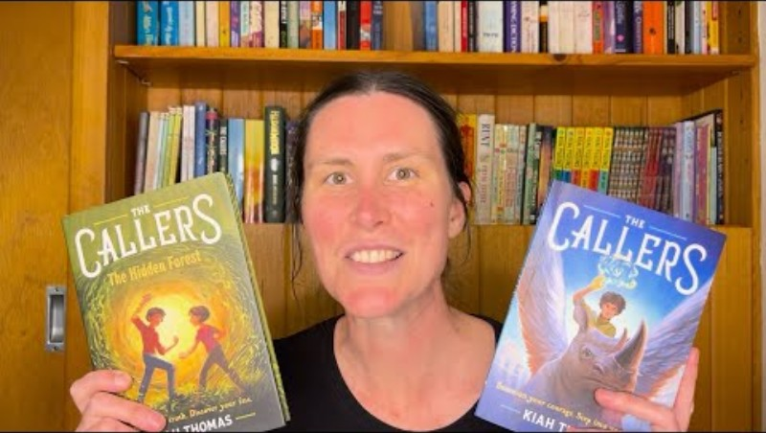

Slide 11
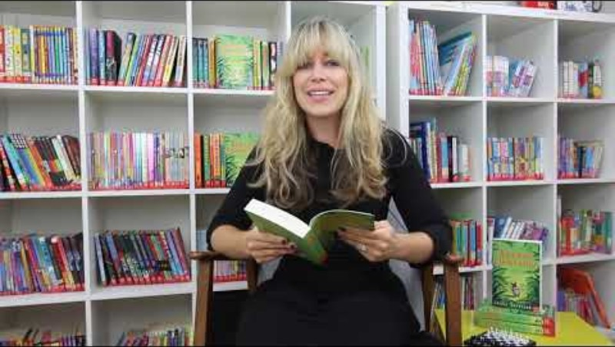

Slide 12
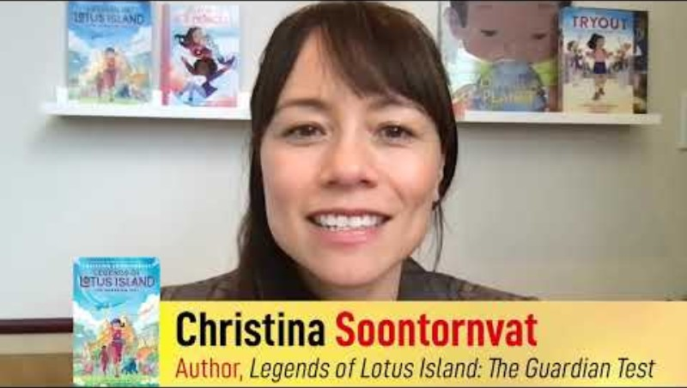

Slide 13
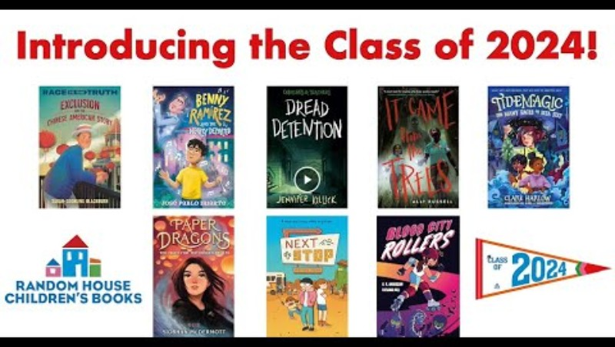

Slide 14


Slide 15


Slide 16



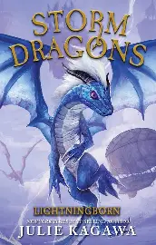
Reviews

